Slide 1
CS 3104 – OPERATING SYSTEMS
Chapter 13 - File-System Interface

Slide 2
CHAPTER 13: FILE-SYSTEM INTERFACE
File Concept
Access Methods
Directory Structure
Protection
Memory-Mapped Files

Slide 3
File-System Interface
The file system provides the mechanism for on-line storage of and access to both data and programs of the operating system and all users of the computer system.
It consists of two distinct parts:
a collection of files, each storing related data
a directory structure, which organizes and provides information about all the files in the system.

Slide 4
File Concept
A file is a named collection of related information that is recorded on secondary storage.
They are usually mapped by the operating system onto physical devices that are usually nonvolatile (persists between system reboots).
Files commonly represent programs and data.

Slide 5
File Attributes
A file’s attributes vary from one operating system to another but typically consists of the following:
Name - Symbolic file name kept in human readable form.
Identifier - A unique tag that identifies the file within the system.
Type - Needed for systems that support different types of files.
Location - A pointer to a device and location of the file on that device.
Size - Size of the file in bytes, words, or blocks.
Protection - Determines who can do reading, writing, executing, etc.
Timestamps and user identification - Kept for creation, last modification, and last use.

Slide 6
File Operations
The operating system can provide system calls to create, write, read, reposition, delete, and truncate files.
Most operating systems require that files be opened before access, and closed after all access is complete.
Information about currently open files is stored in an open file table containing the following:
File pointer - records the current position in the file
File-open count - How many times the current file has been opened.
Disk location of the file
Access rights

Slide 7
File Operations
Some systems provide support for file locking.
File locks allow one process to lock a file and prevent other processes from gaining access to it.
A shared lock is for reading only.
An exclusive lock is for writing and reading.
An advisory lock is informational only and not enforced.
A mandatory lock is enforced.
UNIX uses advisory locks, while Windows uses mandatory locks.

Slide 8
File Types
In designing a file system, we always consider whether the operating system should recognize and support file types.
A file type is usually implemented by including it as a part of the file name. The file name is separated into the name itself, and an extension.
The system uses the extension to indicate the file type and the different operations that can be done on that file.
The UNIX system uses a magic number stored at the beginning of some binary files to indicate the type of data in the file. (Not all files have magic numbers)
Extensions can be used or ignored by a given application, depending on the application’s programmer.

Slide 9
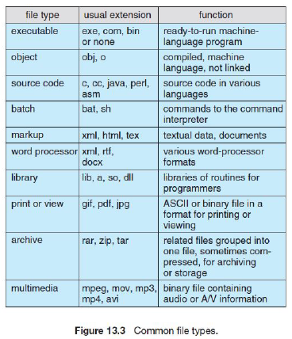
Common File Types

Slide 10
File Structure
File types can be used to indicate the internal structure of the file.
Source and object files have structures that match the expectations of the programs that read them.
The structure must be understood by the operating system.
Operating systems that support multiple file structures tend to be large and cumbersome.
UNIX treats all files as sequence of bytes, with no further consideration of the internal structure.
Macintosh files have two forks - a resource fork and a data fork.
The resource fork contains information relating to the UI.
The data fork contains the code or data.

Slide 11
Internal File Structure
Disk files are accessed in units of physical blocks, typically 512 bytes.
Files are organized in units of logical units, which may be a single byte or up to a larger size depending on the data structure..
The number of logical units which fit into one physical block determines its packing, and has an impact on the amount of internal fragmentation that occurs.
Because disk space is always allocated in blocks, some portion of the last block of each file is generally wasted.
All file systems suffer from internal fragmentation.

Slide 12
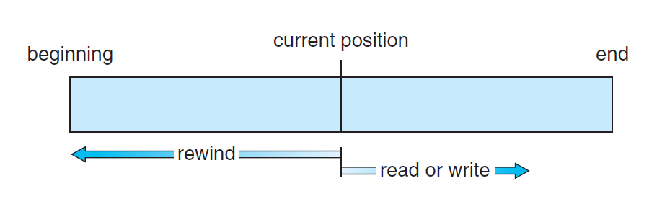
Access Method: Sequential Access
The simplest access method, the information is processed in order, one record after the other.
Reads and writes make up the bulk of the operations on a file.
This mode of access is by far the most common.

Slide 13
Access Method: Direct Access
The file is viewed as a numbered sequence of blocks or records.
There are no restrictions on the order of reading or writing for a direct-access file.
The file operations must be modified to include the block number.
Read(n), where n is the block number rather than read next()
Write(n)
Jump to record n
Query current record
Sequential access can be easily emulated using direct access, but not the other way around.

Slide 14
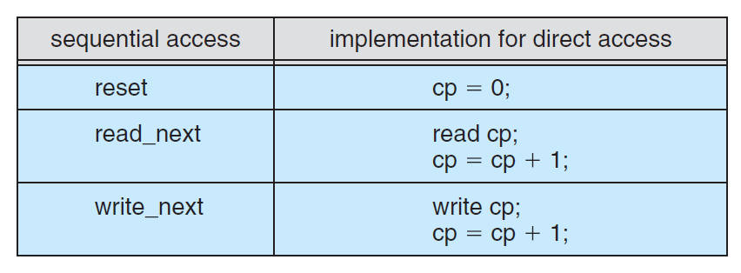
Simulation of Sequential Access on a Direct-Access File

Slide 15
Other Access Methods
Other access methods can be built on top of a direct-access method.
These methods generally involve the construction of an index for the file.
The index contains pointers to various blocks.
To find a record in the file, we first search the index and then use the pointer to access the file directly and to find the desired record.
With large files, the index file itself may become too large to be kept in memory.
One solution is to create an index for the index file.

Slide 16
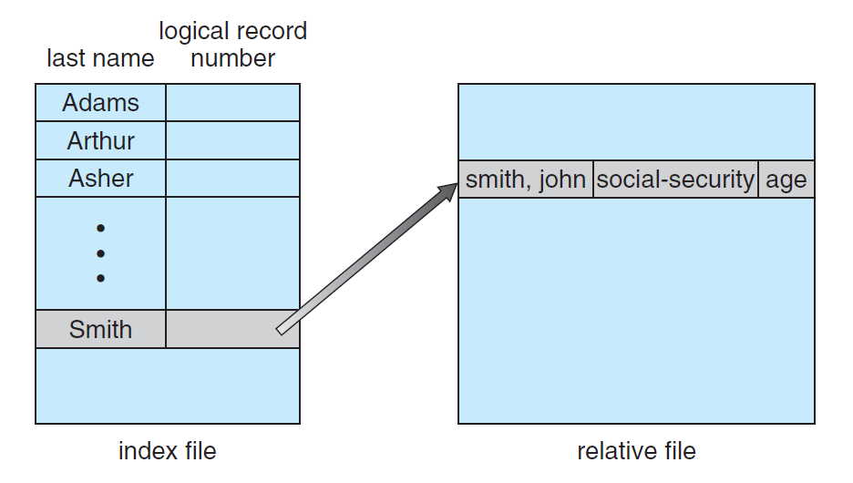
Other Access Methods

Slide 17
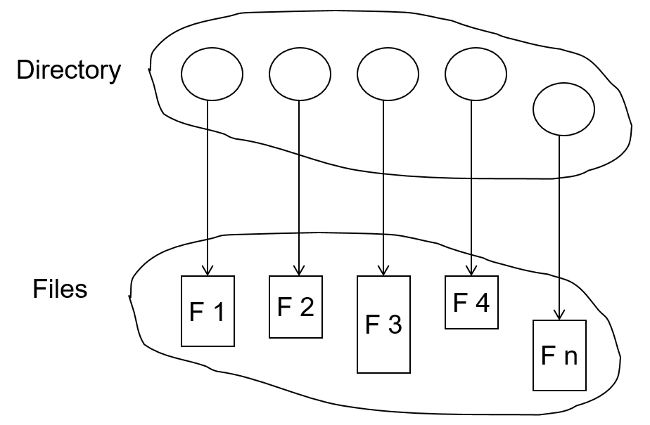
Directory Structure
A collection of nodes containing information about all files
Both the directory structure and the files reside on disk

Slide 18
Disk Structure
Disk can be subdivided into partitions
Disks or partitions can be RAID protected against failure
Disk or partition can be used raw – without a file system, or formatted with a file system
Partitions also known as minidisks, slices
Entity containing file system known as a volume
Each volume containing file system also tracks that file system’s info in device directory or volume table of contents
As well as general-purpose file systems, there are many special-purpose file systems, frequently all within the same operating system or computer

Slide 19
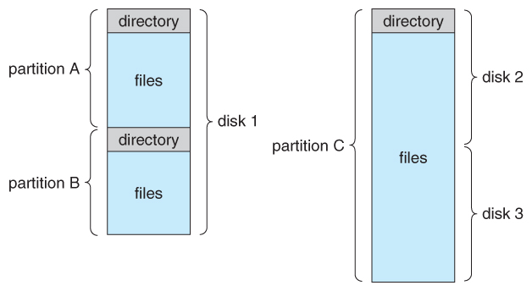
A Typical File-System Organization

Slide 20
Types of File Systems
We mostly talk of general-purpose file systems
But systems frequently have many file systems:
some general- purpose
some special- purpose
Consider Solaris, it has:
tmpfs – memory-based volatile FS for fast, temporary I/O
objfs – interface into kernel memory to get kernel symbols for debugging
ctfs – contract file system for managing daemons
lofs – loopback file system allows one FS to be accessed in place of another
procfs – kernel interface to process structures
ufs, zfs – general purpose file systems

Slide 21
Operations Performed on Directory
Search for a file
Create a file
Delete a file
List a directory
Rename a file
Traverse the file system

Slide 22
Directory Organization
The directory is organized logically to obtain:
Efficiency – locating a file quickly
Naming – convenient to users
Two users can have same name for different files
The same file can have several different names
Grouping – logical grouping of files by properties, (e.g., all Java programs, all games, etc.)

Slide 23
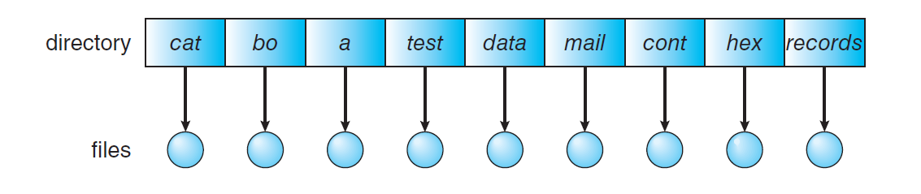
Single-Level Directory
A single directory for all users
Naming problem
Grouping problem

Slide 24
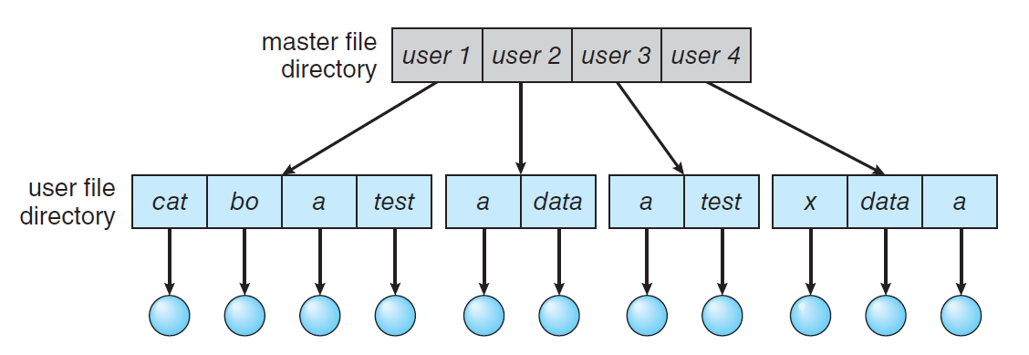
Two-Level Directory
Separate directory for each user
Path name
Can have the same file name for different user
Efficient searching
No grouping capability

Slide 25
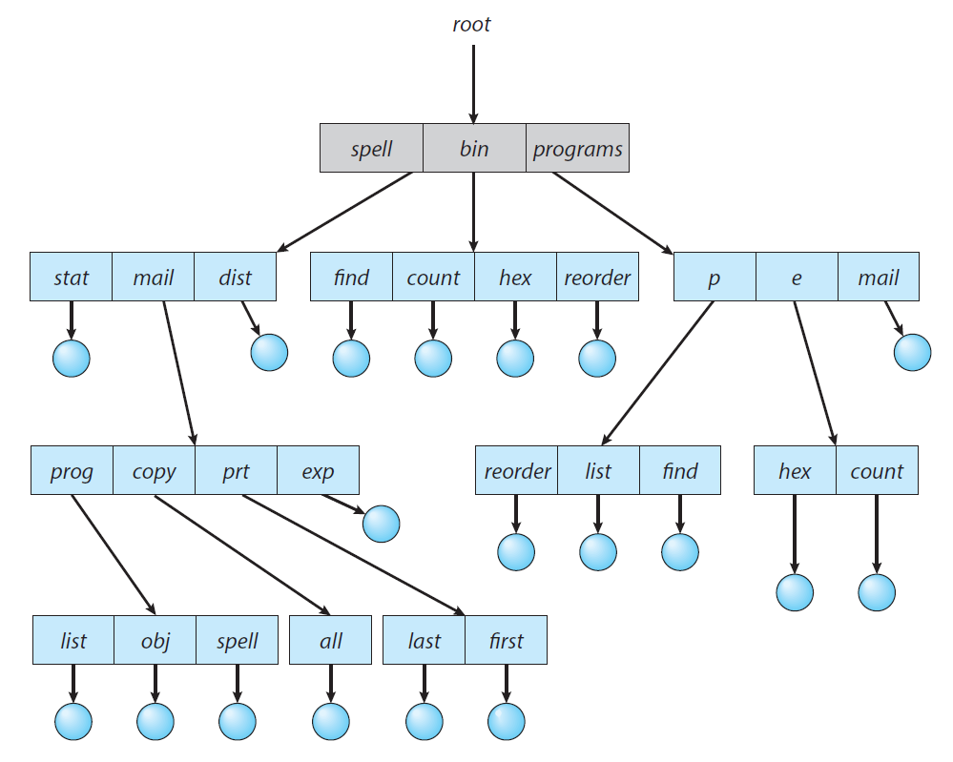
Tree-Structured Directories

Slide 26
Tree-Structured Directories
Efficient searching
Grouping Capability
Current directory (working directory)
cd /spell/mail/prog
type list

Slide 27
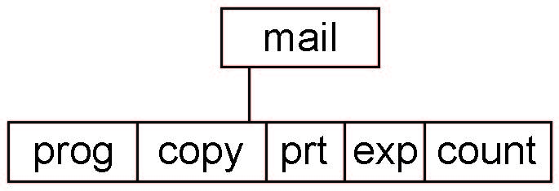
Tree-Structured Directories
Absolute or relative path name
Creating a new file is done in current directory
Delete a file
rm <file-name>
Creating a new subdirectory is done in current directory
mkdir <dir-name>
Example: if in current directory /mail
mkdir count
Deleting “mail” ⇒ deleting the entire subtree rooted by “mail”

Slide 28
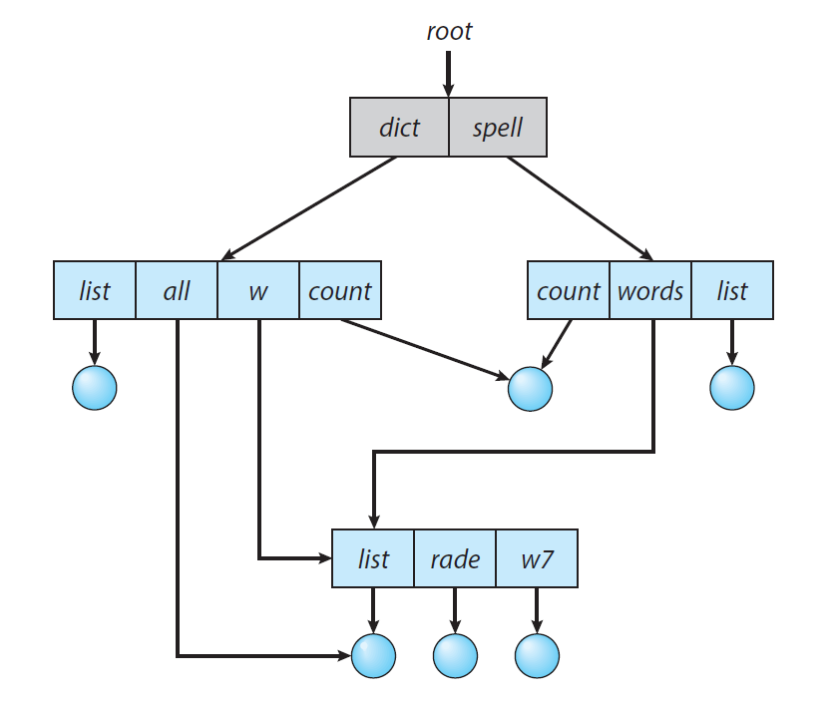
Acyclic-Graph Directories
Have shared subdirectories and files

Slide 29
Acyclic-Graph Directories
Two different names (aliasing)
If dict deletes list ⇒ dangling pointer
Solutions:
Backpointers, so we can delete all pointers Variable size records a problem
Backpointers using a daisy chain organization
Entry-hold-count solution
New directory entry type
Link – another name (pointer) to an existing file
Resolve the link – follow pointer to locate the file

Slide 30
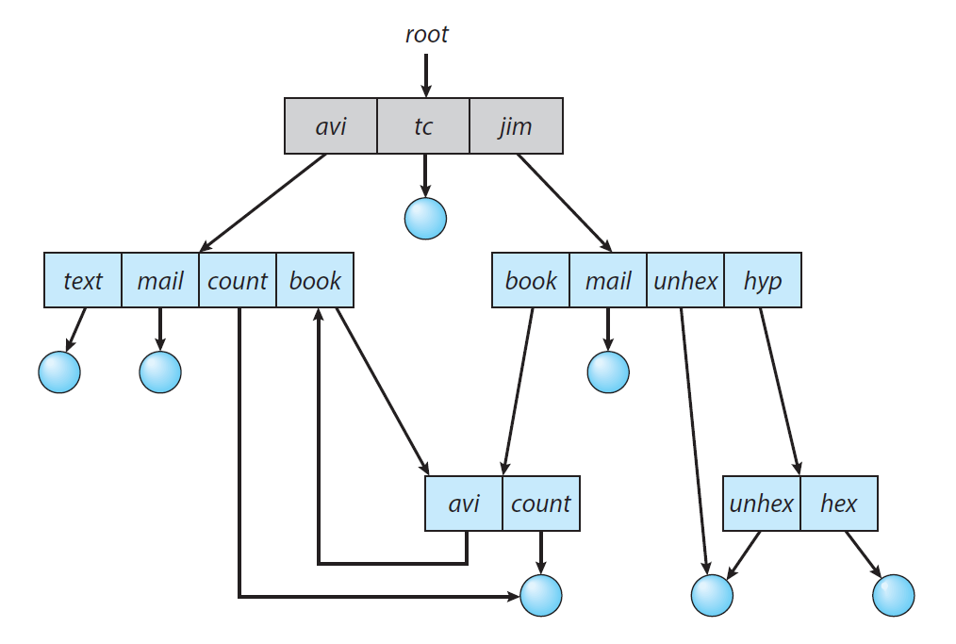
General Graph Directory

Slide 31
General Graph Directory
How do we guarantee no cycles?
Allow only links to file not subdirectories
Garbage collection
Every time a new link is added, use a cycle detection algorithm to determine whether it is OK

Slide 32
Protection
File owner/creator should be able to control:
what can be done
by whom
Types of Access:
Read. Read from the file.
Write. Write or rewrite the file.
Execute. Load the file into memory and execute it.
Append. Write new information at the end of the file.
Delete. Delete the file and free its space for possible reuse.
List. List the name and attributes of the file.
Attribute change. Changing the attributes of the file.

Slide 33
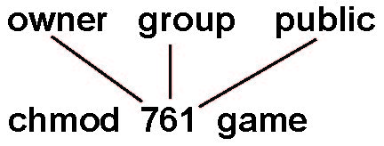
Access Lists and Groups
Mode of access: read, write, execute
Three classes of users on Unix / Linux
RWX
a) owner access 7 ⇒ 1 1 1 RWX
b) group access 6 ⇒ 1 1 0
RWX
c) public access 1 ⇒ 0 0 1
Ask manager to create a group (unique name), say G, and add some users to the group.
For a particular file (say game) or subdirectory, define an appropriate access.

Slide 34
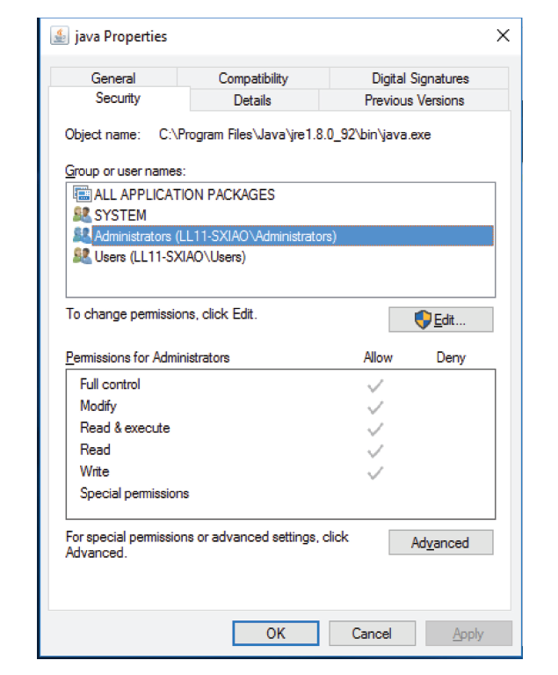
Windows 10 Access Control List Management

Slide 35
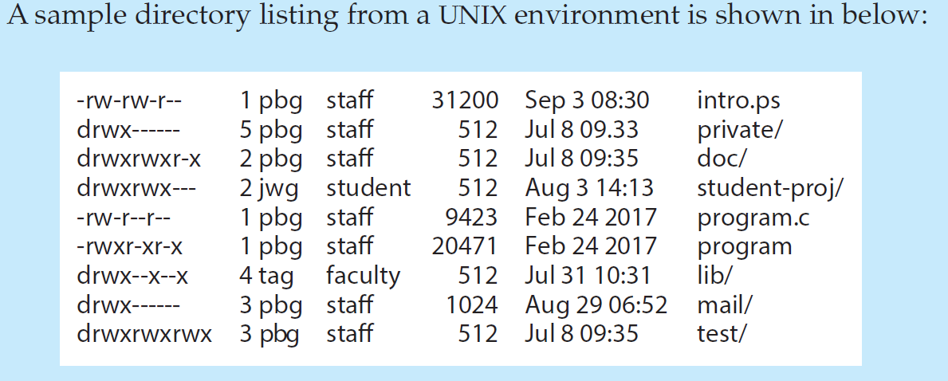
A Sample UNIX Directory Listing

Slide 36
Memory-Mapped Files
Mapping a disk block to a page (or pages) in memory
Allows a part of the virtual address space to be logically associated with the file
Uses the virtual memory techniques to treat file I/O as routine memory accesses

Slide 37
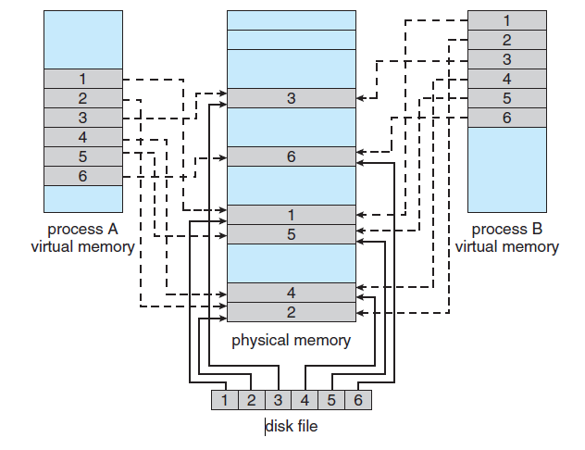
Memory-Mapped Files
The virtual memory map of each sharing process points to the same page of physical memory (the page that holds a copy of the disk block)

Slide 38
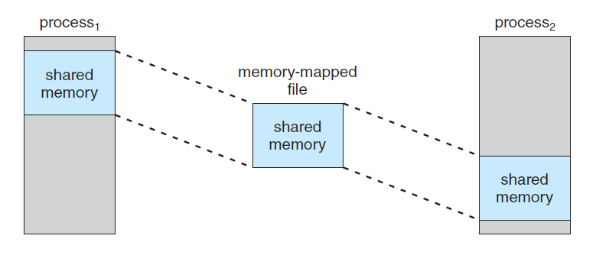
Shared Memory using Memory-Mapped I/O
Processes can communicate using shared memory by having the communicating processes memory-map the same file into their virtual address spaces

Slide 39
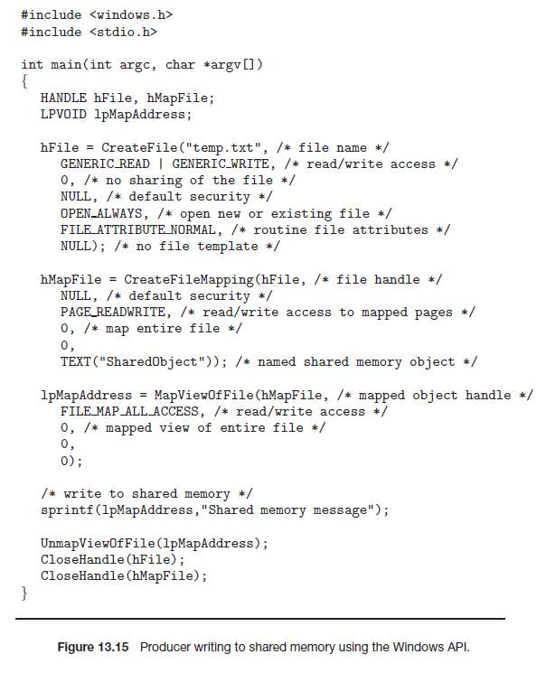
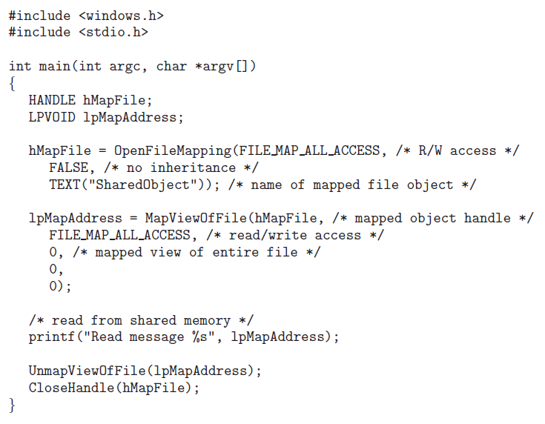
Shared Memory in the Windows API
Producer writing to shared memory using the Windows API
Consumer reading from shared memory using the Windows API

Slide 40
CS 3104 – OPERATING SYSTEMS
End of Chapter 13
File-System Interface

